Slide 1




Danish Ahmad AP22110010234 CSE - L

Slide 2


Disney + Hotstar
Disney+ Hotstar is a leading streaming platform in India, offering a wide array of content and features:
Extensive Content Library: Access over 100,000 hours of TV shows and movies across 17 languages, including exclusive Hotstar Specials.
Live Sports Streaming: Watch major global sporting events, including cricket, football, and more, with live coverage and highlights.
Disney+ Integration: Enjoy Disney+ Originals, popular Disney movies, and kids' shows in multiple languages
Personalized Recommendations: Receive tailored content suggestions based on your viewing history and preferences.

Slide 3

Recommender System
A recommender system is an algorithmic approach designed to predict and suggest items that a user might like. These systems use patterns in data, like user behaviors, past interactions, and similarities between items, to make personalized recommendations.

Slide 4
Different Approaches Within Recommender Systems
Collaborative Filtering: Recommends items based on similarities between users (user-based) or items (item-based). It relies on user interactions, like ratings or purchases, to find patterns in preferences.
Content-Based Filtering: Recommends items based on the characteristics or features of the items a user has previously liked. For instance, if a user likes action movies, it will recommend other action movies.
Hybrid Methods: Combine collaborative and content-based filtering to improve accuracy by leveraging both user and item data.

Slide 5
How It Works
Data Collection: Recommender systems start by collecting data about users, items, and interactions. This data can include user preferences, purchase history, ratings, clicks, or browsing history. The more data available, the better the system can learn and make accurate predictions.
Modeling User Preferences: The system creates a model to understand each user’s tastes or preferences. For instance, a model may capture that a particular user likes sci-fi movies or prefers organic products. This helps in identifying what types of items the user may be interested in.
Making Predictions: Using the preference model, the system predicts how likely a user is to interact with new items (like products or media). It assigns relevance scores to items based on their potential interest to each user.

Slide 6
How It Works
Recommendation Generation: The system presents items with the highest predicted relevance scores to the user as recommendations. These are often displayed as "You might like…" or "Recommended for you" on websites or apps.
Feedback Loop: Recommender systems continuously learn from new user interactions (like clicks, likes, or purchases) to refine future recommendations. This makes the recommendations more accurate and personalized over time.

Slide 7
Difference Between Content Based And Collaborative Based Recommendation System
Aspect | Content-Based Filtering | Collaborative Filtering
Approach | Recommends items based on item characteristics or features that match the user’s past preferences | Recommends items based on patterns in user behavior, like ratings or purchases, and similarities between users or items
Data Used | Item features (e.g., genre, tags, description) and user profile history | User interaction data (e.g., ratings, clicks, purchase history)
Personalization | Personalized to each user based on item characteristics they’ve interacted with | Based on similarities in behavior with other users; learns from collective preferences

Slide 8
Difference Between Content Based And Collaborative Based Recommendation System
Aspect | Content-Based Filtering | Collaborative Filtering
Advantages | Works well with new or niche items if their features are known; highly personalized | Can provide diverse recommendations; doesn’t require item-specific details
Limitations | Limited diversity in recommendations; may only recommend similar types of content | Cold start problem (requires sufficient user data); struggles with new or unpopular items
Use Case | Useful for systems with rich item metadata, like news or music apps | Common in platforms with ample user interaction data, like social media and e-commerce

Slide 9


A Recommendation System For Hotstar
Problem Statement
Hotstar, a leading on-demand video streaming service in India with over 100 million users and 35,000 hours of content, sought to deliver a personalized viewing experience to each user. With a diverse library of movies spanning multiple genres and languages, Hotstar aimed to leverage user data to boost content consumption and engagement, ultimately driving revenue growth.
To meet these goals, Hotstar challenged the development of a recommendation system capable of:
Personalizing the user experience.
Increasing content consumption on the platform.
Improving user engagement and revenue.

Slide 10
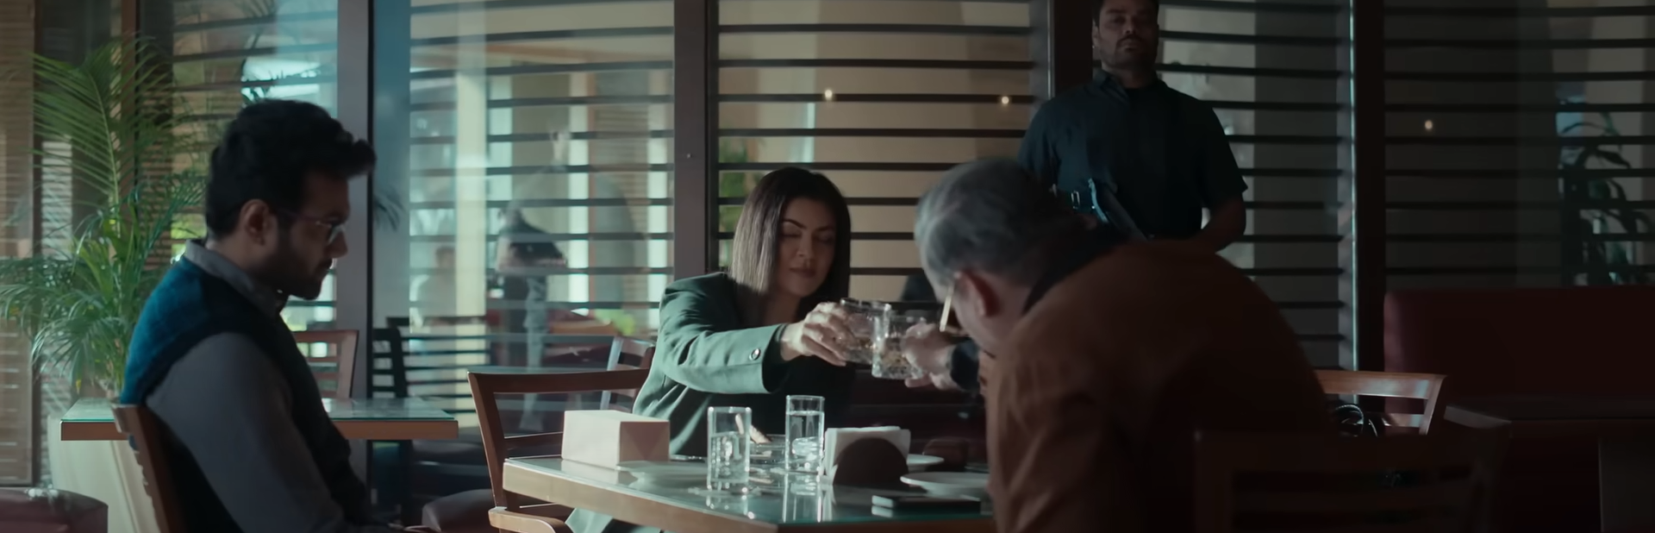




Modelling Strategy
Due to the diversity in user engagement levels, the recommendation system was designed to use two distinct modeling approaches to effectively cater to different user segments:
Rare Users: For users with limited watch history, a heuristics-based model was developed. This model recommended top movies by calculating the watch time-to-duration ratio as a proxy for user interest. The system assumed that a higher watch percentage indicated stronger user interest, providing recommendations based on overall viewership patterns. This simple, effective approach formed the core of the recommendation system and contributed to 95% of the final score

Slide 11
Modelling Strategy
Non-Rare Users: For users with a significant watch history, a collaborative filtering (CF) model was developed using Keras and TensorFlow. This model generated embedding vectors for users and movies to capture complex behavioral patterns. To further enhance personalization, the model incorporated features like genre and language to match users’ specific tastes with relevant content. The collaborative filtering approach was especially effective for identifying content preferences among engaged users.

Slide 12

Challenges and Solutions
A major challenge in building recommendation systems is the cold start problem, which occurs when limited data is available for new users or items. To address this, Hotstar’s system used the heuristics model to recommend popular content for new users based on general viewing patterns. As users interacted with more content, they were moved into the non-rare users segment, enabling the collaborative filtering model to refine recommendations. The collaborative filtering model was also designed to scale with increasing data volumes, easily adapting to future growth by adding GPU capacity.

Slide 13
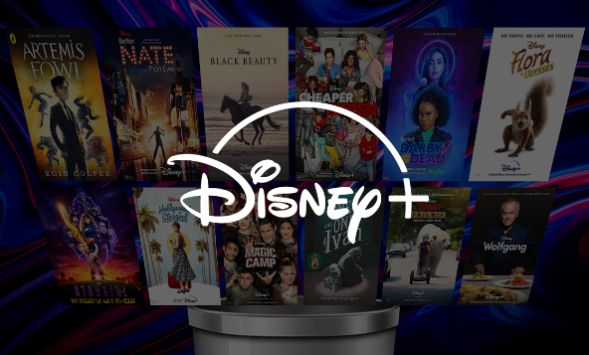

Results and Performance
The baseline model achieved an NDCG (Normalized Discounted Cumulative Gain) score of 0.07. With the dual-model approach, the recommendation system achieved an NDCG score of 0.201, a significant improvement. Further optimization, including filtering out low-frequency movies and low-engagement content, increased performance to 0.24 — almost a 3x lift over the baseline.

Slide 14
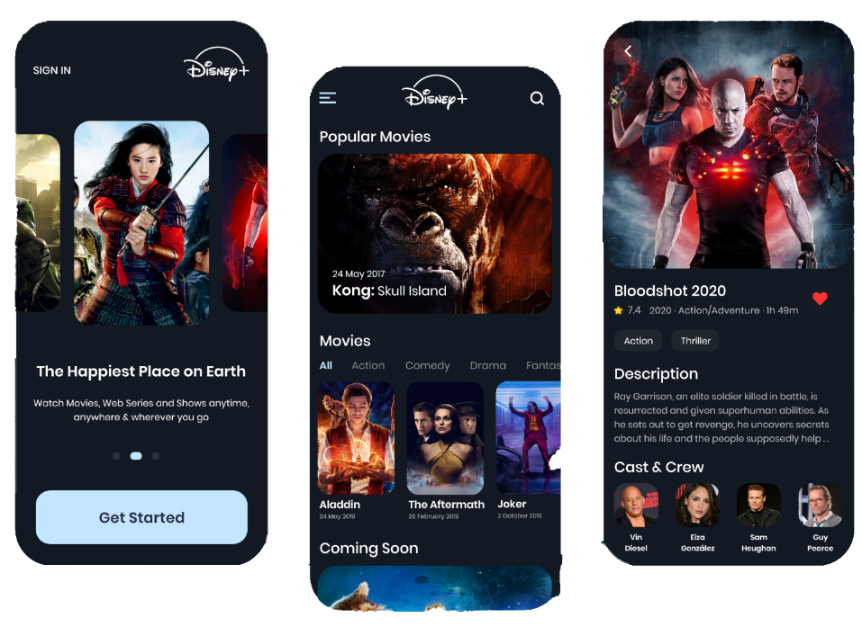
Impact and Takeaways
This case study demonstrates the value of:
Segmented user handling to address varying engagement levels within large datasets.
Hybrid approaches combining heuristics and collaborative filtering to manage different data needs across user segments.
Cold start solutions to gradually transition new users into more personalized recommendation processes.

Slide 15
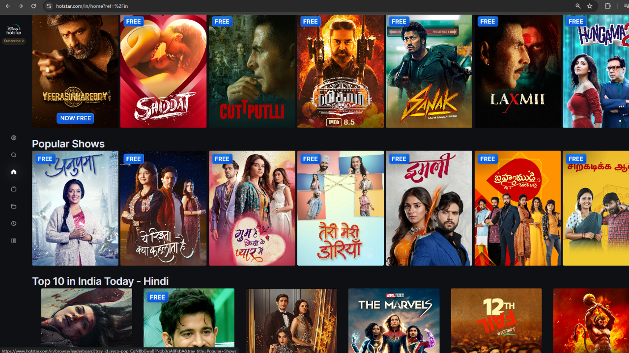
Conclusion
Hotstar’s hybrid recommendation system effectively personalized user experiences by using a dual-model approach for different user segments. The heuristics model addressed the cold start problem for new users, while collaborative filtering provided deeper personalization for engaged users. This approach significantly boosted recommendation performance, increased content consumption, and improved user satisfaction, showcasing the power of scalable, tailored recommendation systems in enhancing engagement and driving growth

Slide 16
Thanks

